Slide 1


SLHS-SIM
Design Lead - Devika Pradhan
Hang Yang
Liaison- Michael Wu
Taoyue Zhang
Spring 2015 Mid-Semester Design Review

Slide 2
Partners
In coöperation with the Purdue Department of Speech, Language, and Hearing Sciences (SLHS)
Primary contacts:
Barbara Cicholski, M.A. (Speech and language pathology)
Anu Subramanian, Ph. D. (Clinical associate professor; Speech and language pathology)

Slide 3
Objectives
To design and implement an online simulation of the Peabody Picture Vocabulary Test Fourth generation (PPVT-IV) for students studying in SLHS-related fields to practice administering the exam

Slide 4
Objectives
Create an online database for storing the videos, forms, and answers
Fully implement scoring features and user feedback
If time permits, we would also like to create an administrative console that can be used to more easily add additional videos to the simulation

Slide 5
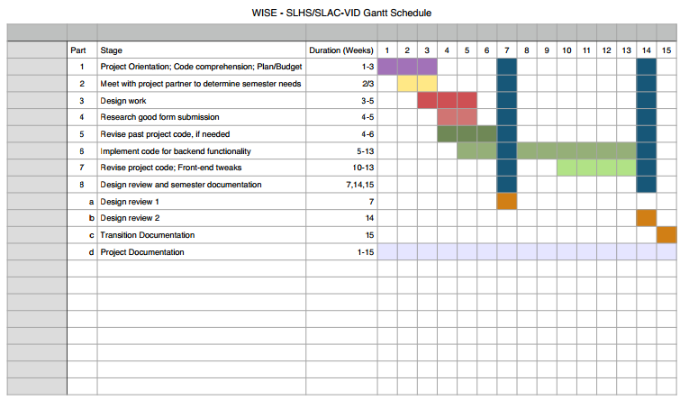
Timeline

Slide 6
Progress
Met with Prof. Cicholski to review last semester’s progress and revise any residual objectives
Cleaning up code from previous team’s work to better suit project needs
Clean and intuitive implementation of required functions

Slide 7
What We Have Done This Semester
Until now, our group have met with all the previous team members and project partner in the department of Speech, Language, and Hearing Sciences. From the meeting with the previous members, we understood what our project is about and what we should continue to do on this project. We have worked on revising the original simulation to be more humanist and intuitive, while simultaneously incorporating new functionality to meet project goals.
More importantly, we received the actual form of the PPVT test and a CD-R of the simulation videos, which are the most crucial items we need in this project.

Slide 8
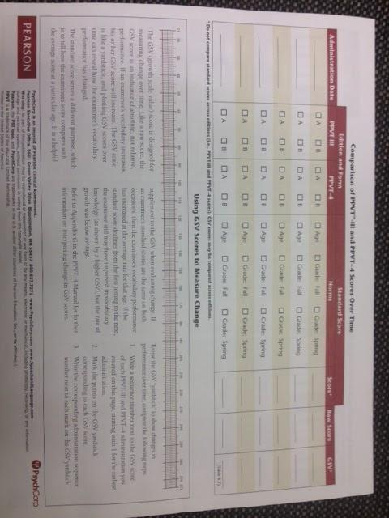
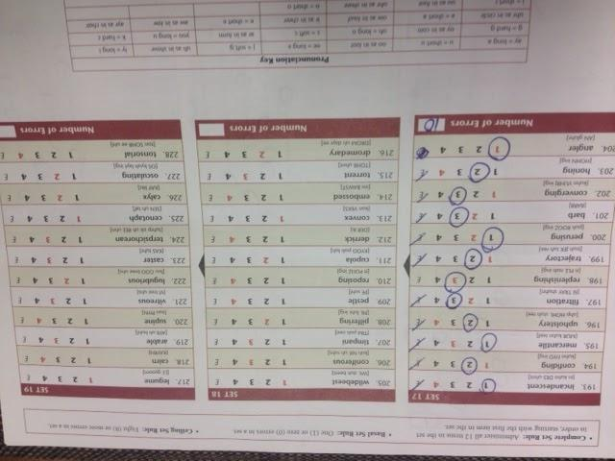
PPVT Form

Slide 9
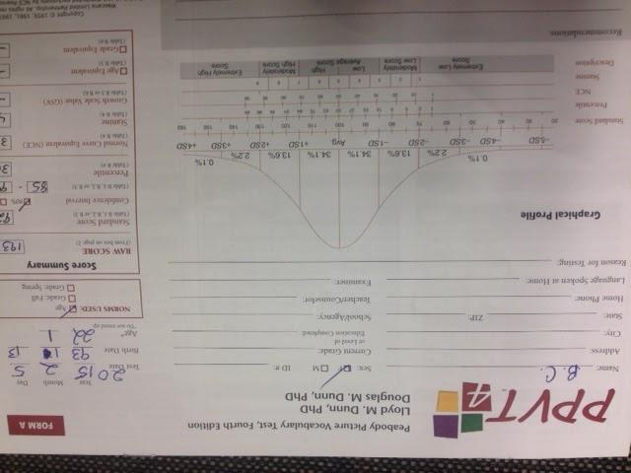
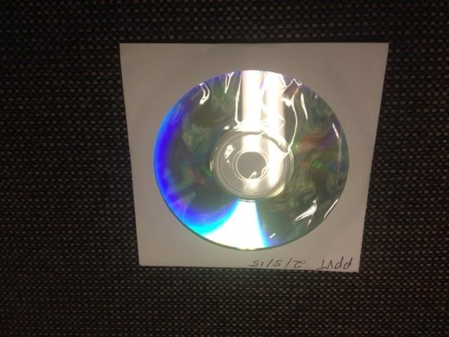
PPVT Form and CD

Slide 10
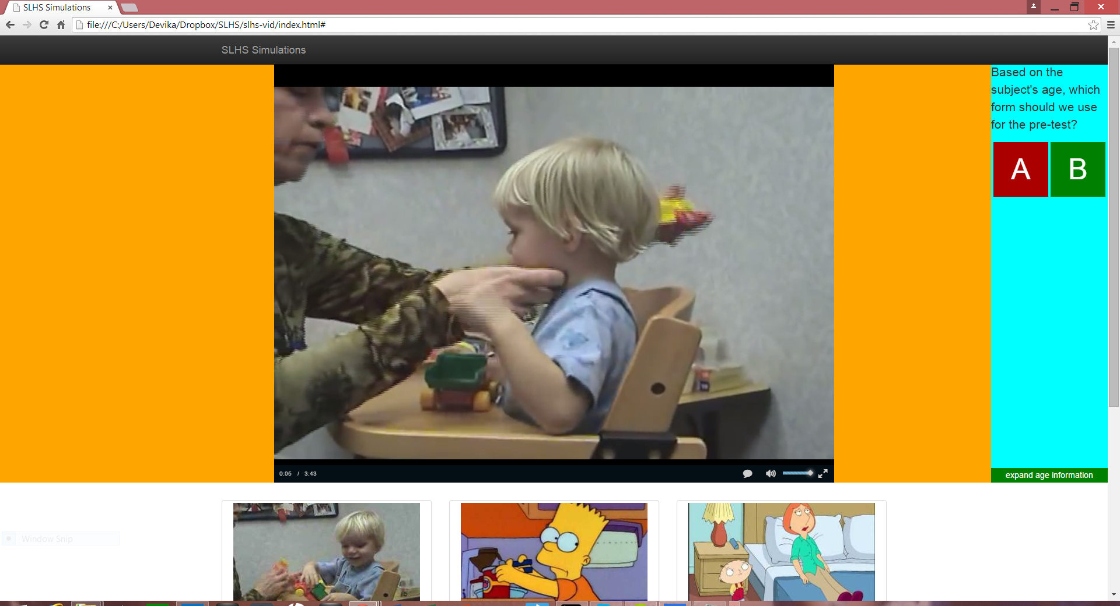
Simulation Slides

Slide 11
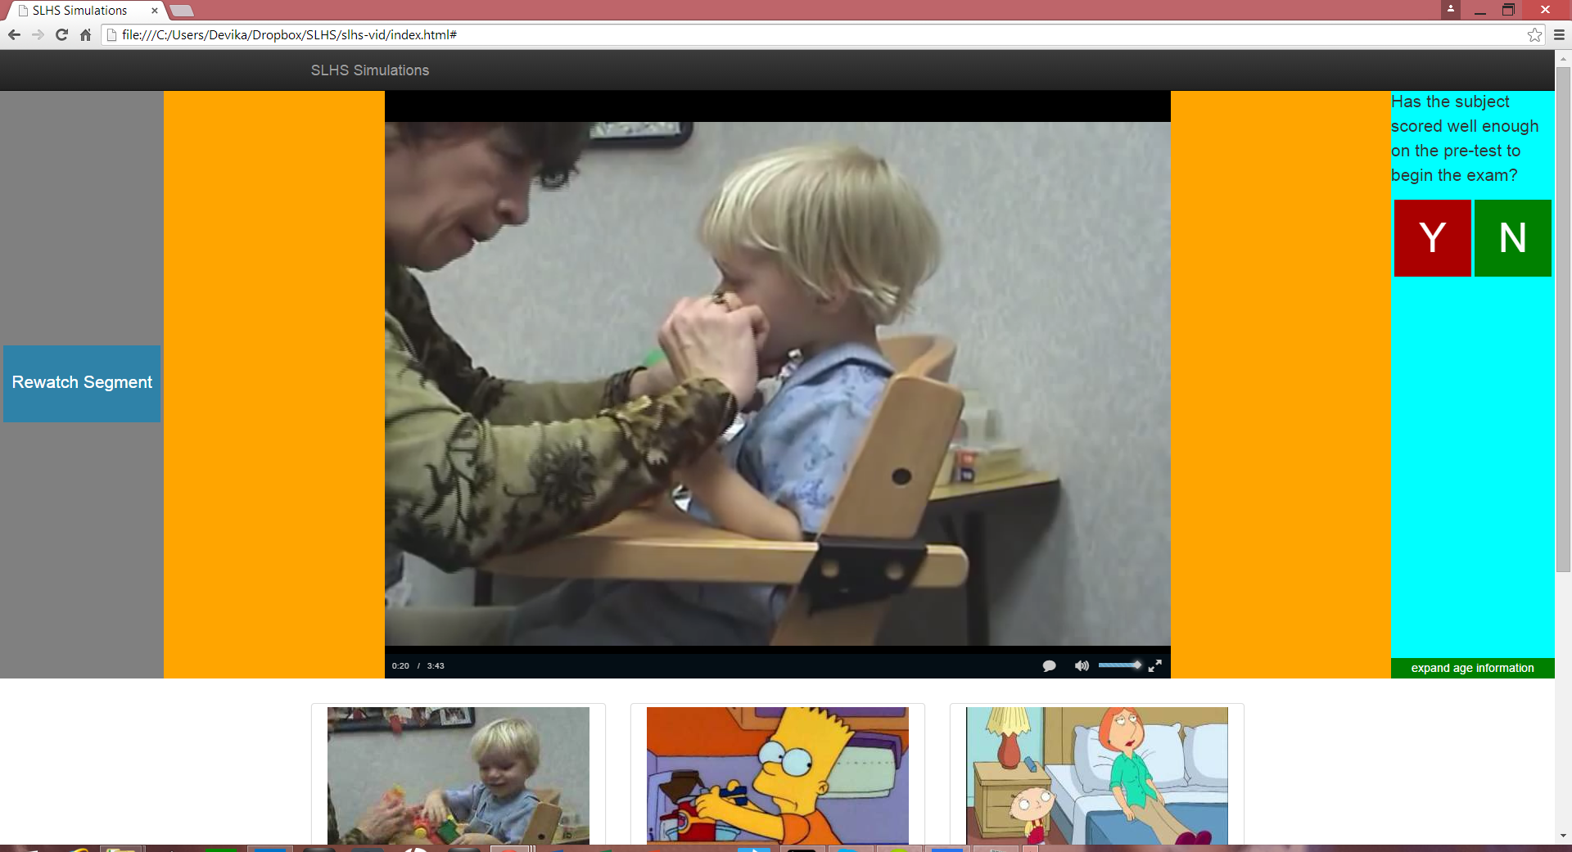

Slide 12
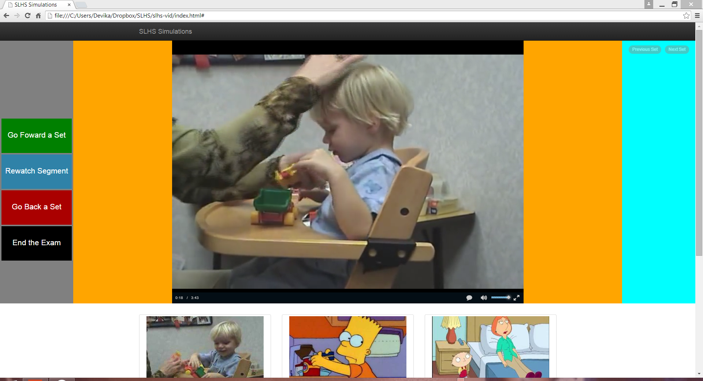

Slide 13
Specs of the Simulation and Code
The time stamps are flexible and will eventually be stored in a database
The simulation records user responses to give performance feedback, but most importantly reinforces concept by informing the student of incorrect responses and explaining why
Subject can review segments of the simulation, but cannot go back (currently - this option is still available)
Integrates Jquery and Javascript using online standard libraries, although the goal is eventually to eliminate all the but the most necessary (jquery and bootstrap)

Slide 14
Technology Credits
jQuery
JavaScript
HTML5/CSS3
Owl carousel (likely to be purged)
videojs
bootstrap

Slide 15
SWOT Analysis
Strengths
We made the site more user friendly and flexible for the subject to experiment with.
Weaknesses
The simulation doesn’t incorporate all the constraints like age, number of past attempts in consideration, etc.
Opportunities
With the videos in our hands, we can now test the simulation in a realistic-scenario
Threats
For better results, we need all members to become proficient with coding

Slide 16
Semester Goals
As a team work on making the simulation vidoes subject friendly and making the site interactive. Fulfilling all the aforementioned objectives will realize this
Individually, we each want to use this opportunity to broaden our knowledge of and experience with succinct programming

Slide 17
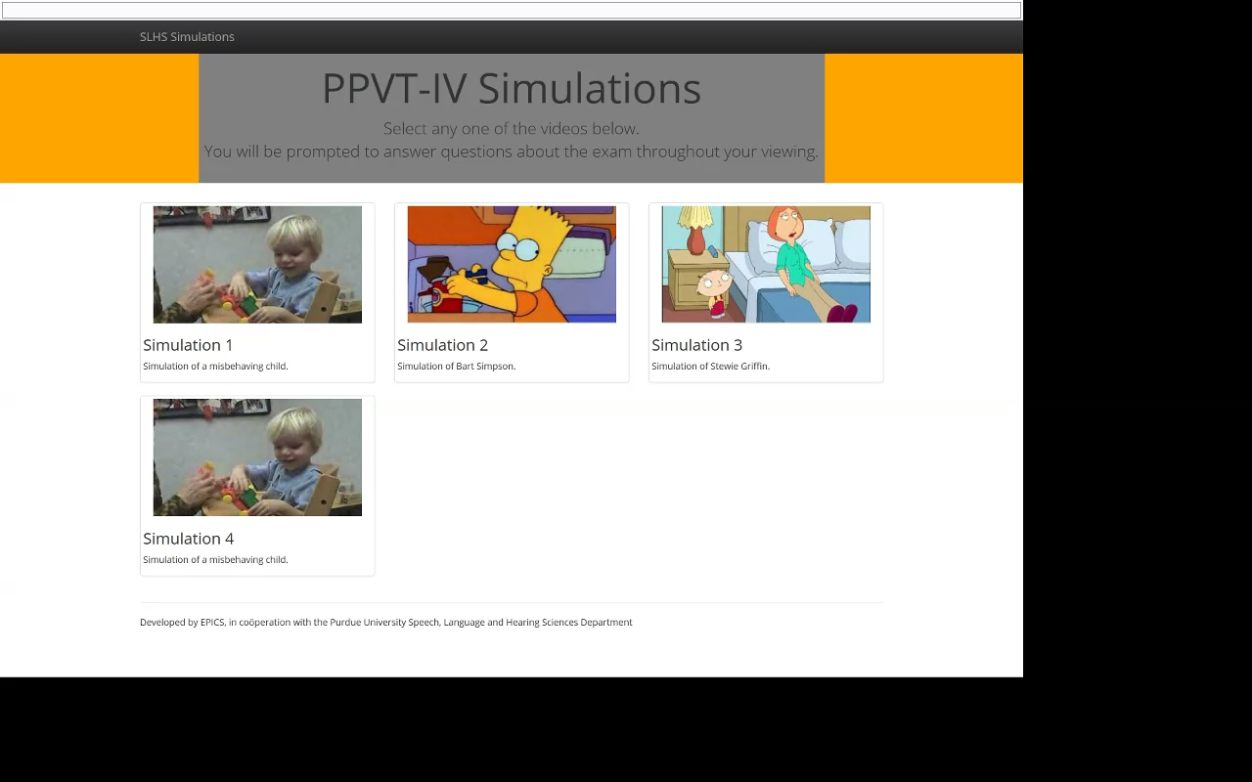
Video of simulation in action

Slide 18
